Slide 1
Data 601: Property Assessment Exploratory Data Analysis
By: Dany Hachem, Atlanta Liu, & Greg Cameron

Slide 2
Property Assessment & Tax Calculator
Sample Property Assessment | $200,000 | $400,000 | $600,000 | $800,000 | $1,000,000
Municipal Property Tax | $842.16 | $1684.32 | $2526.48 | $3368.64 | $4210.80
Provincial Property Tax | $488.64 | $977.28 | $1465.92 | $1954.56 | $2443.20
Total Tax | $1330.80 | $2661.60 | $3992.40 | $5323.20 | $6654.00

Slide 3
Guiding Questions
1. How has the economic downturn (decrease in oil price) affected the residential property assessments in Calgary?
2. How does population growth affect a communities’ property assessments over the years?
3. What is the relationship between crime rates and property assessments?

Slide 4
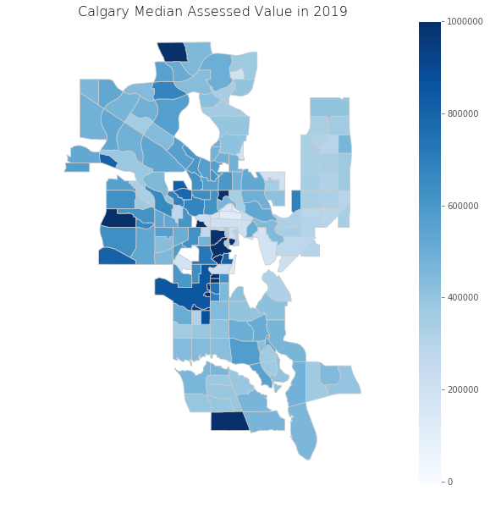
Data Wrangling and Cleaning
Main Dataset – Property Assessments
~ 6 million rows
15 years
190+ Communities
Merged With
Crime dataset
Population dataset
Oil Price dataset
Wrangling and Cleaning
Remove un-needed columns
Remove nan
Remove non-residential
Calculate median value per community per year

Slide 5
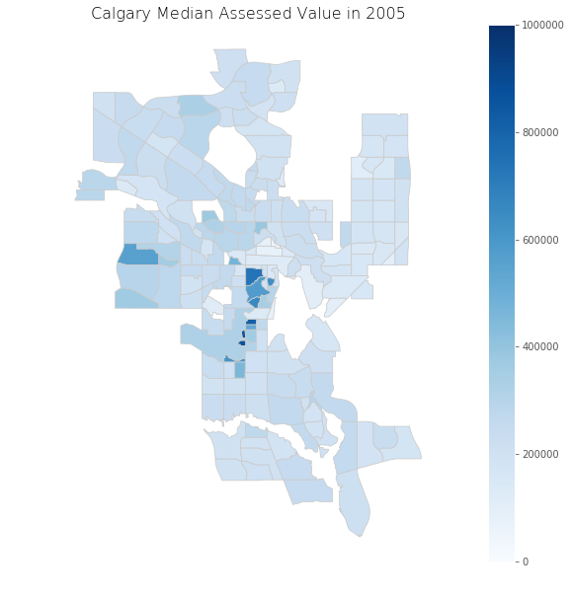
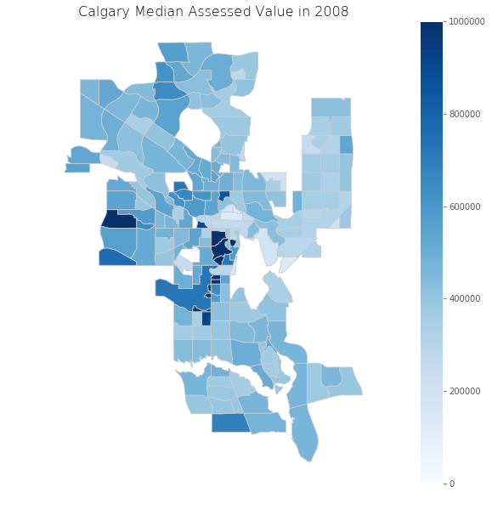
Property Assessments in Calgary – Change over time

Slide 6
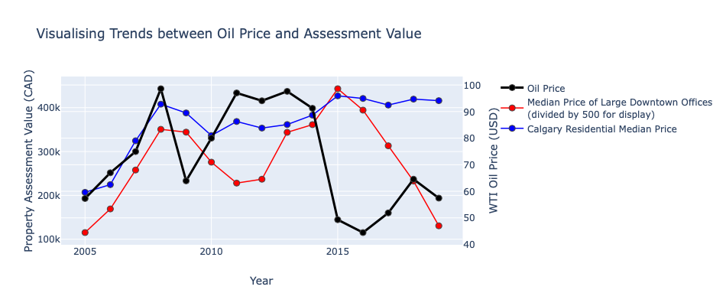
Oil Price Compared to Calgary Properties

Slide 7
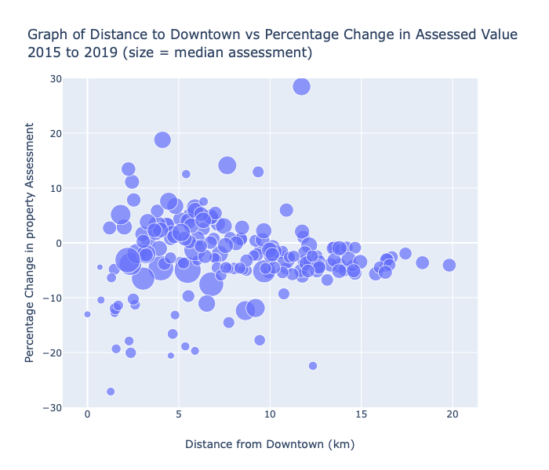
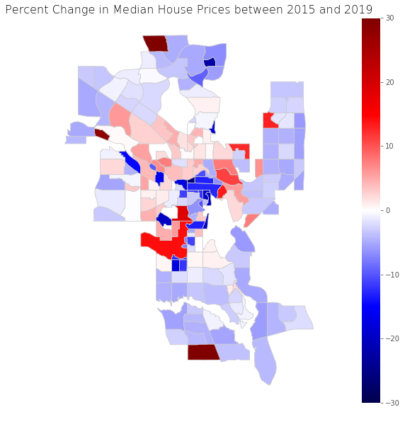
Property Assessments in Calgary – Change over time

Slide 8
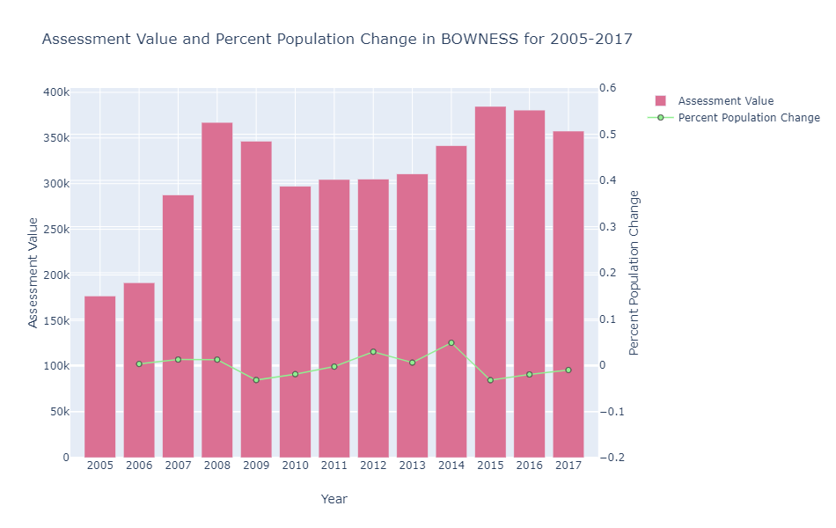
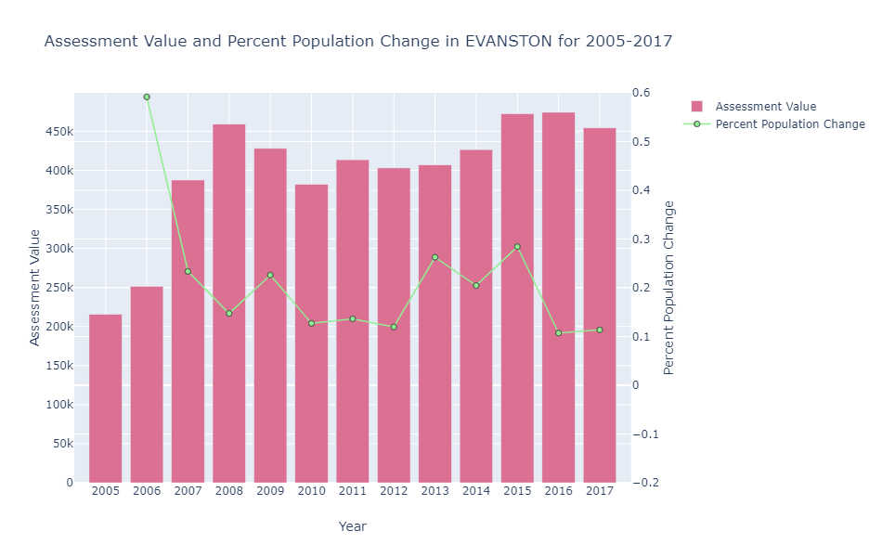
Communal Population Change & Median Property Assessment Bowness vs Evanston

Slide 9
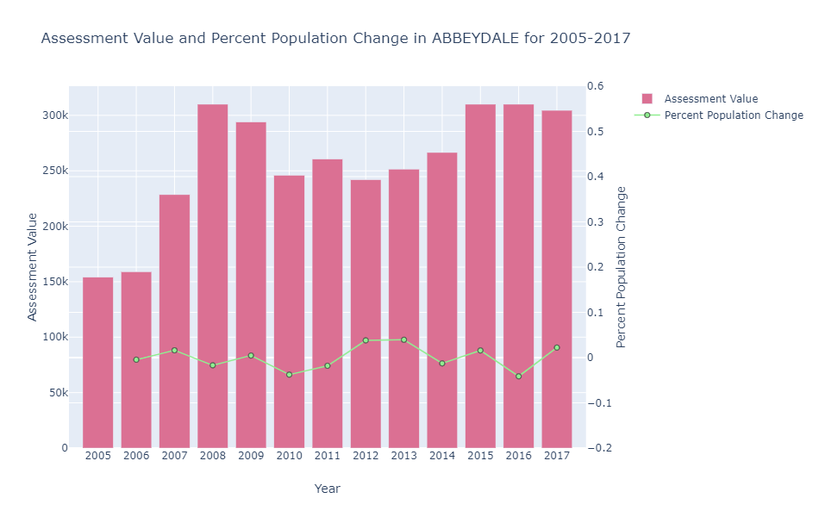
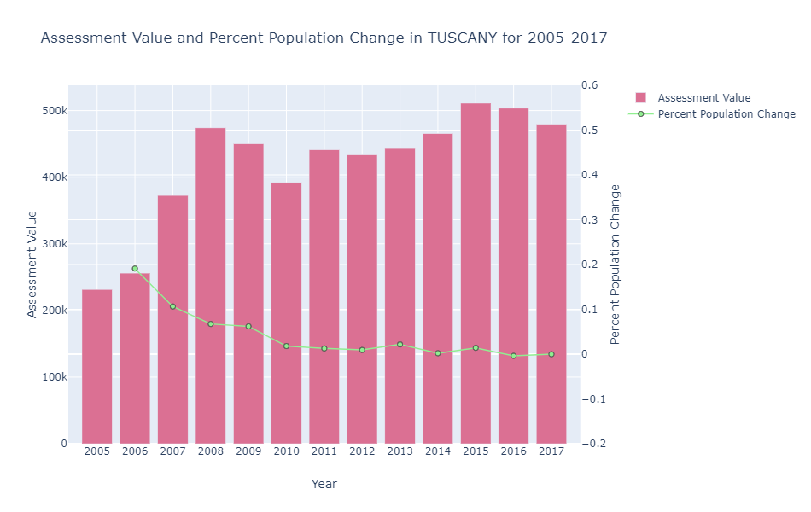
Communal Population Change & Median Property Assessment Abbeydale vs. Tuscany

Slide 10
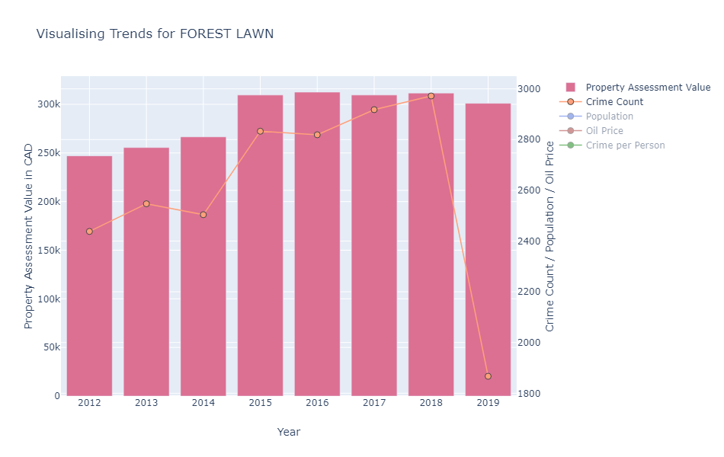
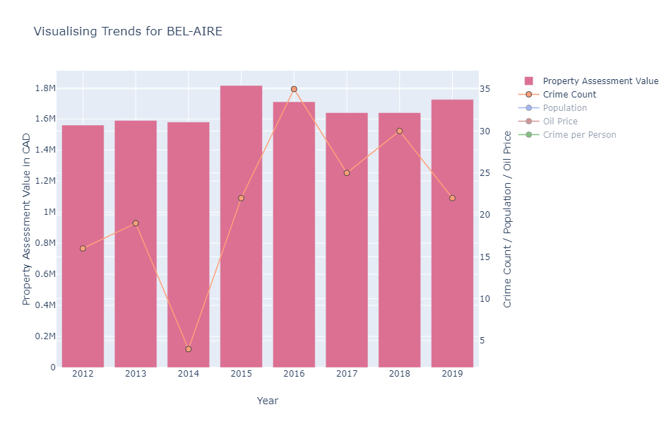
Assessment Values and Crime Count Forest Lawn & Bel-Aire
Strong +ve relationship
Weak -ve relationship

Slide 11
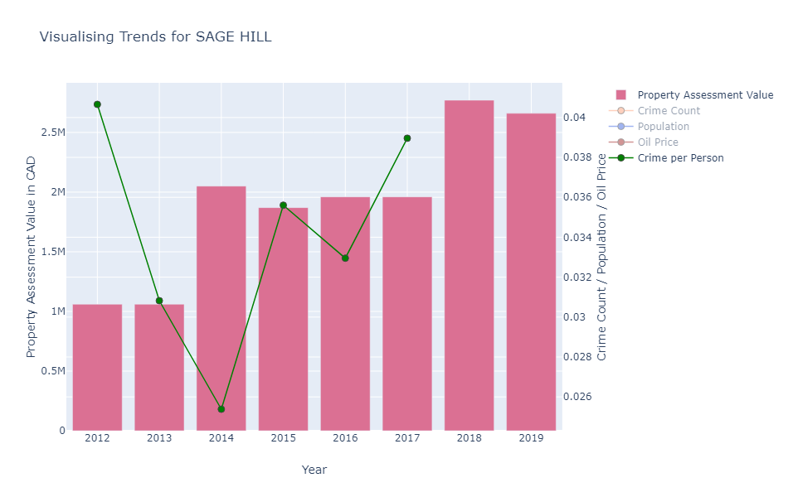
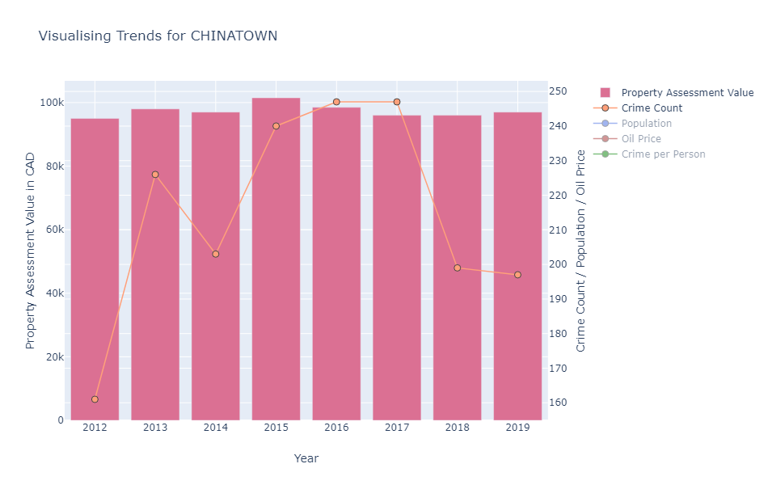
Assessment Values and Crime Count Sage Hill & Chinatown
No relationship
No relationship

Slide 12
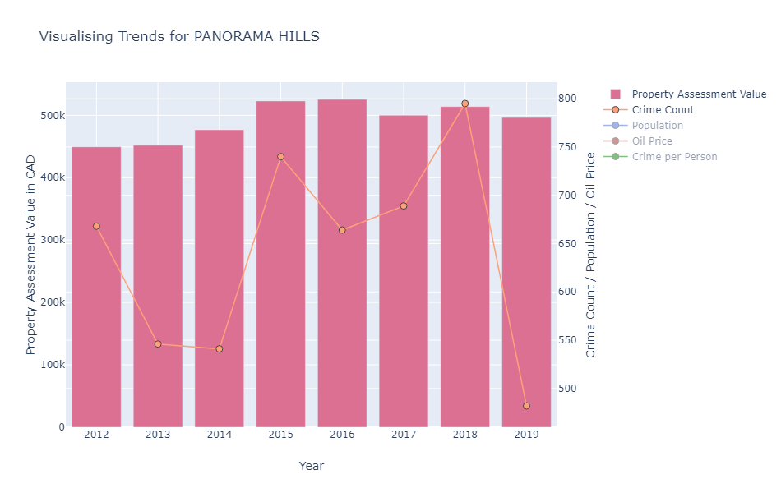
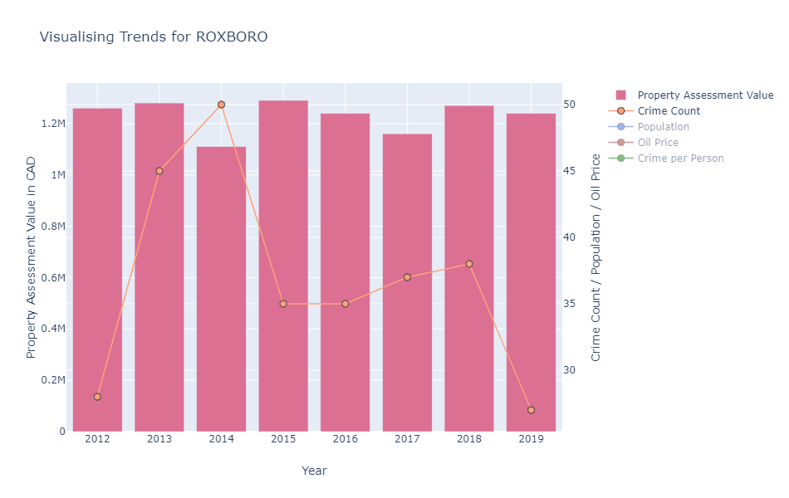
Assessment Values and Crime Count Panorama Hills & Roxboro
Weak -ve relationship
No relationship

Slide 13
Takeaways
Assessment Values and Oil Price ☑
Assessment Values and Population Change ☒
Assessment Values and Crime Count ☒☑

